Slide 1
CSE321: OPERATING SYSTEMS LECTURE :Intro
NARZU TARANNUM(NAT)
LECTURER
DEPT. OF CSE, BRAC UNIVERSITY

Slide 2
Contact
Room: UB50301
Email: narzu.tarannum@bracu.ac.bd
Cell: 01731781858
For PPT slides, Check “TSR” \\tsr\Spring-2019\CSE\NAT

Slide 3
REFERENCE BOOK
SILBERSCHATZ, GALVIN, AND GAGNE, OPERATING SYSTEM PRINCIPLES,
7TH ED/9th edition
A. TANENBAUM, OPERATING SYSTEMS: DESIGN AND IMPLEMENTATION, 2ND ED., PRENTICE-HALL, 2001

Slide 4
Marks Distribution
Quiz (2-3) –20%
Assignment (2) –5%
Mid Term Exam –20%
Final Exam –35%
Lab –20%

Slide 5
Course Outline
Operating Systems Overview and Introduction
Processes
Threads
CPU Scheduling
Process Synchronization
Deadlock
Memory Management
Virtual Memory

Slide 6
WHAT IS AN OPERATING SYSTEM?
A PROGRAM THAT ACTS AS AN INTERMEDIARY BETWEEN A USER OF A COMPUTER AND THE COMPUTER HARDWARE.
OPERATING SYSTEM GOALS:
EXECUTE USER PROGRAMS AND MAKE SOLVING USER PROBLEMS EASIER.
MAKE THE COMPUTER SYSTEM CONVENIENT TO USE.
USE THE COMPUTER HARDWARE IN AN EFFICIENT MANNER.

Slide 7
WHAT IS AN OPERATING SYSTEM?
Resource allocator – manages and allocates resources.
Control program – controls the execution of user programs and operations of I/O devices .
Kernel – the one program running at all times (all else being application programs).

Slide 8
TO UNDERSTAND WHAT OS ARE, WE MUST FIRST UNDERSTAND HOW THEY HAVE DEVELOPED.

Slide 9
HISTORY OF OS
Simple Batch Systems
Multiprogramming Batched Systems
Time-Sharing Systems
Personal-Computer Systems
Parallel Systems
Distributed Systems
Real -Time Systems

Slide 10
HISTORY OF OS
SIMPLE BATCH SYSTEMS: automatically transfers control from one job to another.
MULTI-PROGRAMMED BATCHED SYSTEMS: (Several jobs are kept in main memory at the same time, and the CPU is multiplexed among them.)
TIME SHARING SYSTEMS:(Logical extension of multiprogramming.)
PERSONAL-COMPUTER SYSTEMS: (computer system dedicated to a single user.)
PARALLEL SYSTEMS
DISTRIBUTED SYSTEMS: (Distribute the computation among several physical processors.
Loosely coupled system – each processor has its own local memory; processors communicate with one another through various communications lines, such as high-speed buses or telephone lines.)
REAL-TIME SYSTEMS: (Often used as a control device in a dedicated application such as controlling scientific experiments, medical imaging systems, industrial control systems, and some display systems.)

Slide 11
COMPUTER-SYSTEM ARCHITECTURE
SINGLE-PROCESSOR SYSTEMS : If there is only one general purpose CPU, then the system is a single-processor system.
MULTIPROCESSOR SYSTEMS/PARALLEL SYSTEM : Multiprocessor systems with more than one CPU in close communication.
Tightly coupled system – processors share memory and a clock; communication usually takes place through the shared memory.
HAVE THREE MAIN ADVANTAGES :-
INCREASED THROUGHPUT
ECONOMY OF SCALE
INCREASED RELIABILITY

Slide 12
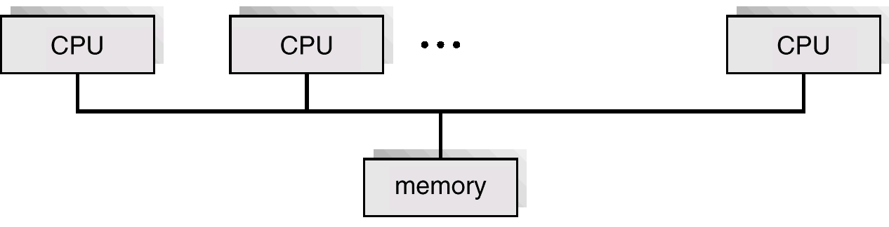
MULTIPROCESSOR SYSTEMS/PARALLEL SYSTEM
TWO TYP ES:
ASYMMETRIC MULTIPROCESSING:
Each processor is assigned a specific task; master processor schedules and allocates work to slave processors
SYMMETRIC MULTIPROCESSING(SMP):
Each processor runs an identical copy of the operating system.
Most modern operating systems support SMP.

Slide 13
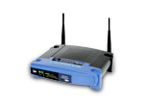

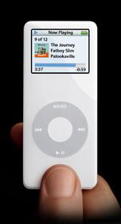
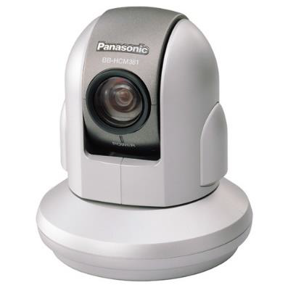

COMPUTING ENVIRONMENT
CLIENT-SERVER SYSTEMS
MAIL SERVER/SERVICE
FILE SERVER/SERVICE
COMPUTE-SERVER SYSTEM
PEER-TO-PEER (P2P) SYSTEMS:
P2P COMPUTING OR NETWORKING IS A DISTRIBUTED APPLICATION ARCHITECTURE THAT PARTITIONS TASKS OR WORK LOADS BETWEEN PEERS. PEERS ARE EQUALLY PRIVILEGED, EQUIPOTENT PARTICIPANTS IN THE APPLICATION.
NAPSTER, GNUTELLA ETC.
WEB-BASED COMPUTING
EMBEDDED AND MOBILE SYSTEMS

Slide 14
PRIMARY FUNCTIONS OF AN OS
PROCESSES-PROCESS MANAGEMENT
STORAGE-MEMORY MANAGEMENT
DATA-FILE MANAGEMENT
INPUT/OUTPUT DEVICES-I/O MANAGEMENT

Slide 15
SECONDARY FUNCTIONS OF AN OS
USER ACCOUNTING
LOGGING
UTILITY SOFTWARE-CALCULATOR, CALENDAR, FIND, CLOCK, HELP ETC.

Slide 16
THANK YOU

